Slide 1
Telco PaaS Observability Framework

Slide 2







Generic PaaS OBF Framework
Counters Scraping
Counters Scraping
Prometheus
Counters
collection
NF/K8 Telco Services
Prometheus client libraries
Metricbeat
Kibana KPI Generation and Visualization
Kafka Producer
Log
Generation
ASCII Logs
Retrieve and ship container logs
ASCII Logs
Elastic Search
/data/logs
Logstash
filebits (Log pull)
Alternatively FluentBit/FluentD
EFK/ELK
Alarms/Events
Kafka
Alarms/Events

Slide 3
Telco PaaS Addons OBF Framework
Telco OBF Requirements:
Alarms/events, Counters, logs shall be NF/Service/Service Instance topology labeled (Topology shall include cluster and worker node ID)
Logging mechanism shall support ASCI, Binary and Crash file reliable log/crash file delivery
Counters require (depends on app type) “real time stamp” at this application side and hence Prometheus client modification
Common configuration Day 0, Day 1 and Day 2 framework across OBS compnenets
Fault
Management
Topology Management
Configuration Management
Log Management
Counters Scraping
Marked with:
NF/Service/Service Instance
NF/K8 Telco Services
Prometheus
Counters
collection
Prometheus client libraries
ASCII Logs
Marked with:
NF/Service/Service Instance
Metricbeat
Kibana KPI Generation and Visualization
Kafka Producer
Log
Generation
Retrieve and ship container logs
Elastic Search
/data/logs
Support for binary logs
Logstash
Alarms/Events
Marked with:
NF/Service/Service Instance
FluentBit
EFK/ELK
Kafka
Alarms/Events
Counters correlation and aggregation based on received NF/Service/Service Instance topology
3GPP KPI Generation

Slide 4
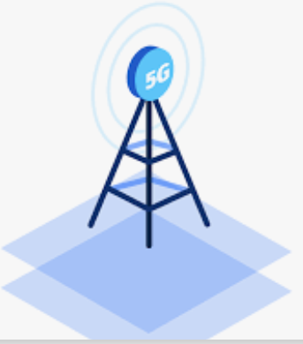
Use Case Counters Collection and 3GPP KPI Generation
Topology Service
Topology Service
Cluster
information
and any
changes
gNB A
gNB B
Cluster
information
and any
changes
2
CU-CP
Microservice A
1
CU-CP
Microservice A
Counters labelled:
NF Id, Service Id,
Cluster Id, Worker Node ID & Source app Time stamp
CU-CP
Microservice B
CU-CP
Microservice B
K8 API
K8 API
CU-UP
Microservice A
CU-UP
Microservice A
CU-UP
Microservice B
CU-UP
Microservice B
Notification includes:
NF Id, Service Id,
Cluster Id, Worker Node ID
Notification includes:
NF Id, Service Id,
Cluster Id, Worker Node ID
DU
Microservice A
DU
Microservice A
DU
Microservice A
DU
Microservice A
Kubernetes
Cluster A
DU
Microservice C
3
DU
Microservice C
Kubernetes
Cluster B
Prometheus
Counters
collection

Slide 5




Use Case Binary Logs (Mainly applicable to RAN)
Telco OBF Requirements:
Local storage can't ephemeral and needs to survive Pod restarts
Crash files require CaaS management and support
Binary parser is required
FluentBit needs to be modfyed to support binary
Kibana
mCMS
SSO
Elastic Search
DU
CUCP
CU-UP
Binary Logs / ASCII Logs
Crash Files
ASCII Logs
Binary
Local
Storage
FluentBit
FluentD
Binary Scraper / Parser

